Slide 1
VASICEK MODEL – EUROPEAN CALL OPTION PRICING
Adabuk, Oguz
Tilly, Olivia
Milewski, Adam

Slide 2
Background
Oldrich Vasicek introduced the model in 1977.
The model uses stochastic calculus to relate a general short rate model to bond prices
The stochastic process of the interest rate is assumed to be:
dr(t) = a(μ_{r}-r(t))dt + σ_{r}dB’(t)
This model describes the movement of the interest rate and predicts the interest rate at the end of a given period.

Slide 3
The Model
dr(t) = a(μ_{r}-r(t))dt + σ_{r}dB’(t)
μ_{r} is the long term mean level of the interest rate
a is the speed of reversion
σ_{r} is the instantaneous volatility of the interest rate
B’(t) is a standard Brownian motion

Slide 4
Key ideas
Mean reversion
Negative interest rates
Long term variance: σ_{r}²/2

Slide 5
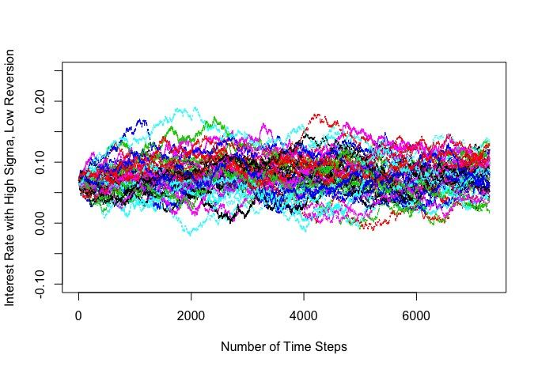
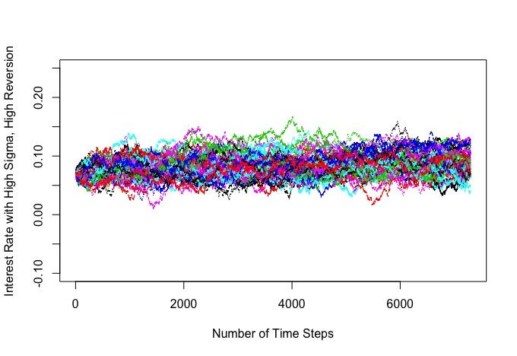
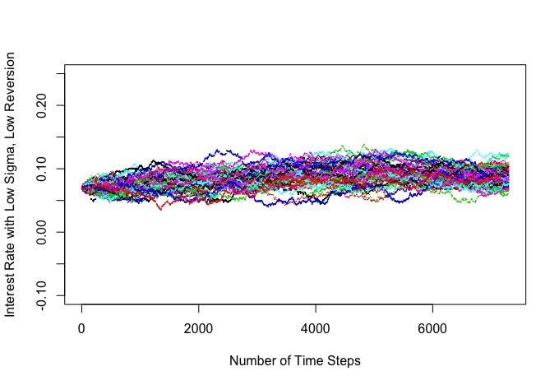
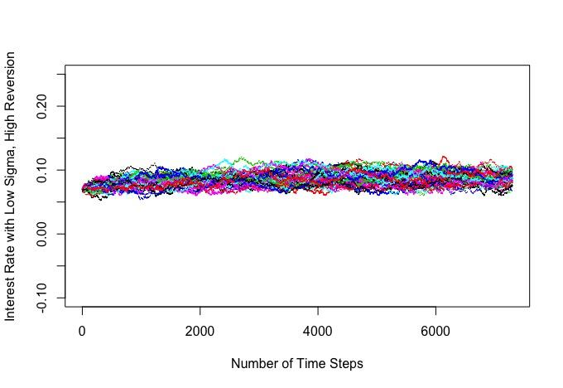
Effects of Volatility and Speed of Mean Reversion

Slide 6
Purpose
We will use the Vasicek model to estimate the European Call Option Price given the following information:
Initial asset price: S(0) = $50
Strike price: K = $50
Initial interest rate: r(0) = 7%
Interest rate: r(t)
Volatility: σ = 13%
Maturity time: T = 1 year

Slide 7

The Simulation

Slide 8
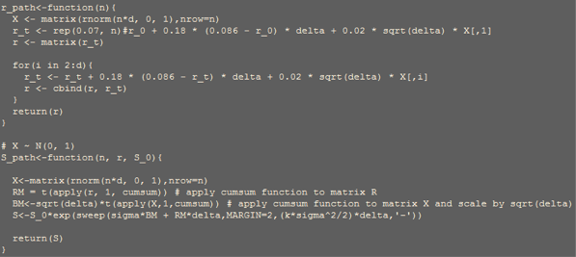
The Code

Slide 9
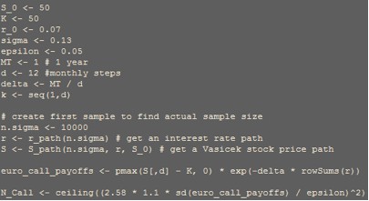
12 Time Steps
Our simulation determined that the required sample size is 89,036 for 12 time steps.

Slide 10
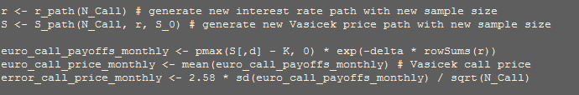
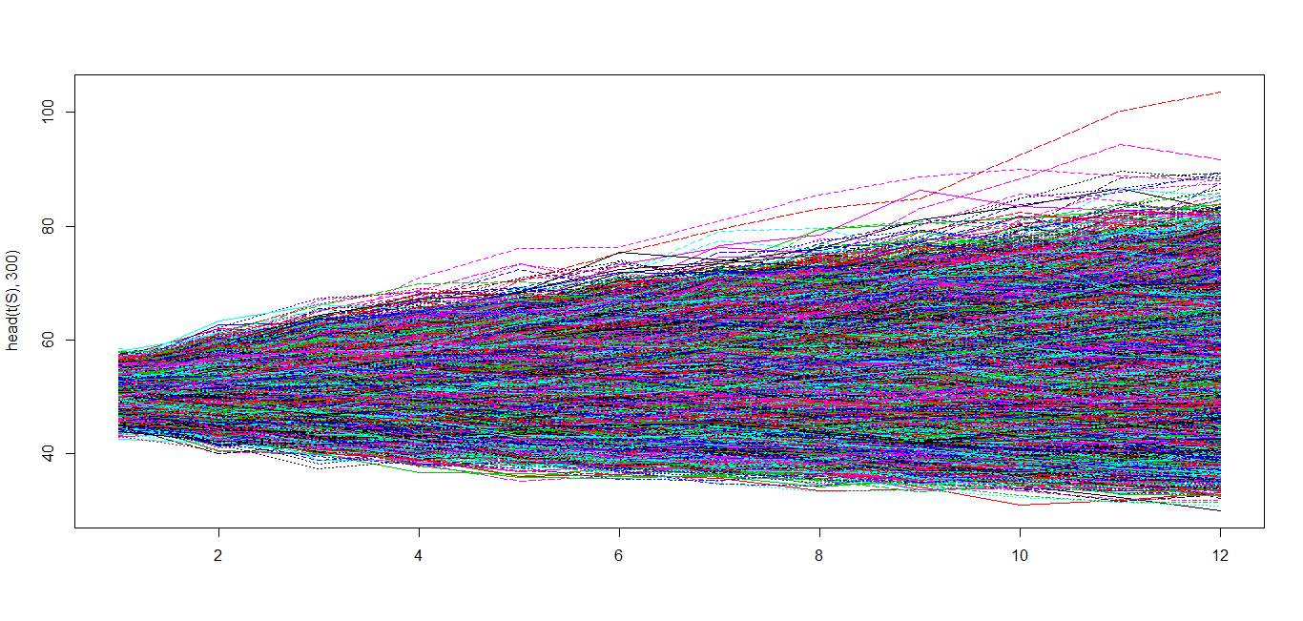
12 Time Steps
The European Call Option price is $4.581664 using the 12 time step approach. This has an error of 0.04506997.

Slide 11
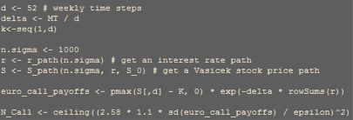
52 Time Steps
Our simulation determined that the required sample size is 82,822 for 52 time steps.

Slide 12

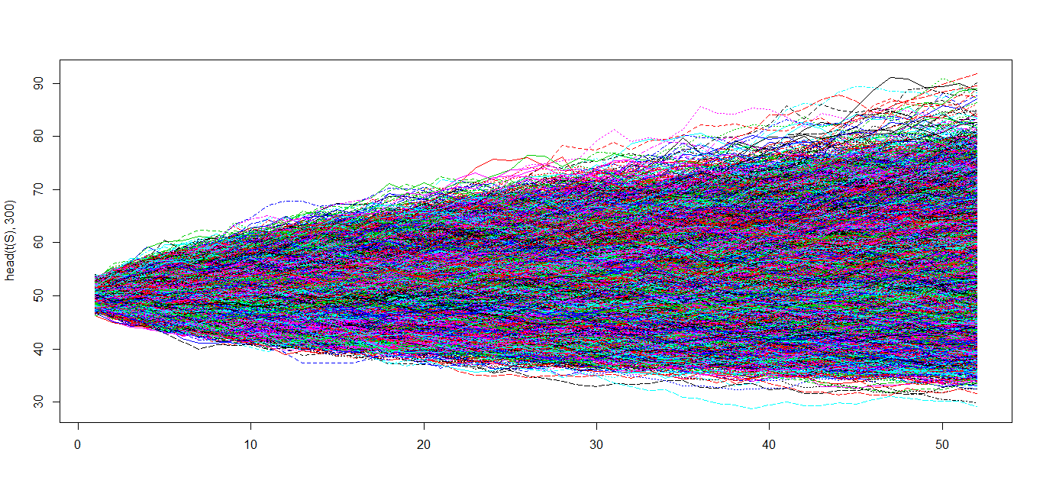
52 Time Steps
The European Call Option price is $4.57992 using the 52 time step approach. This has an error of 0.04440409.

Slide 13
Results
The estimated European Call Option price is higher using a 1-month time step by $0.001744
The pay-off of the European Call Option only depends on the price at the maturity time. The time step size does not affect the convergence of the option price. However the greater the number of time steps used, the simulation time is much longer
Notes:
When using daily, weekly, quarterly, and monthly time steps, each was fairly close to each other.

Slide 14
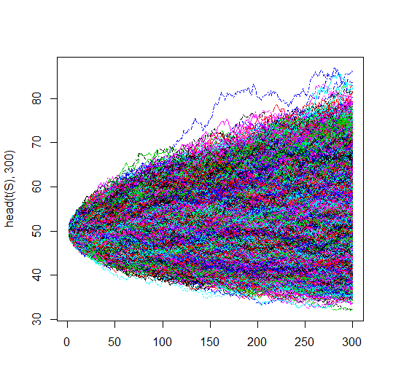
365 Time Steps

Slide 15
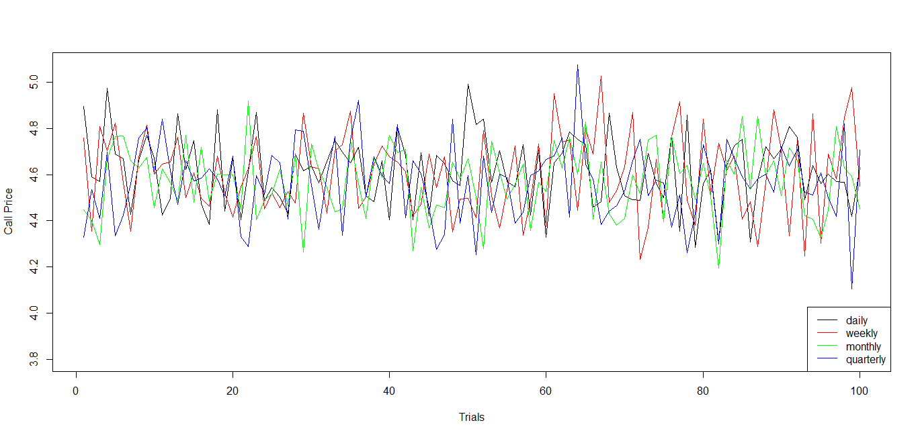
Comparison
Average call price for daily step is $4.602728 with variance 0.02386322
Average call price for weekly step is $4.585089 with variance 0.02651917
Average call price for monthly step is $4.547225 with variance 0.02846235
Average call price for quarterly step is $4.587827 with variance 0.03062879

Slide 16
Results
The computational time of the model is 4.03 seconds to run both versions of time steps.
One way to improve efficiency is to reduce the number of time steps
Another way is to change the way the S path function is coded.

Slide 17
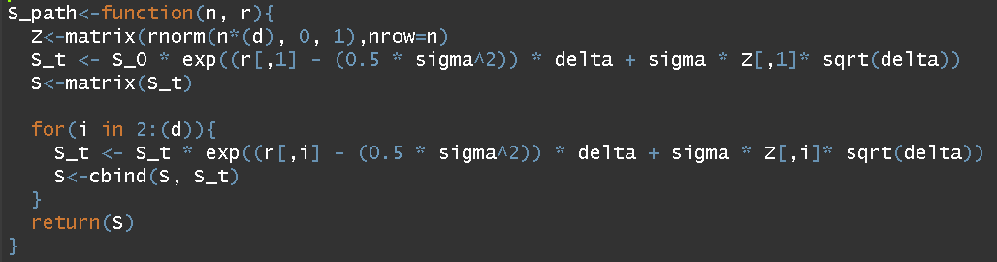
Results
By changing the S path function to the below, we were able to boost program speed by up to 1 second.
Specs: Intel Core i7-7700HQ CPU @ 2.80GHz, 8GM RAM

Slide 18
Results
The price of the European Call Option under a Geometric Brownian motion model with r = 0.07 and σ = 0.13 is $4.530896 with relative error 0.003678078 for a 1-month time step
Under the same conditions, the price of the European Call Option is $4.557864 with relative error 0.00225202 for a 1-week time step
These results are both lower than the ones obtained by the Vasicek Model as it does not use varying interest rates
The exact European Call Option price using the Black Scholes Model is ~$4.547623

Slide 19
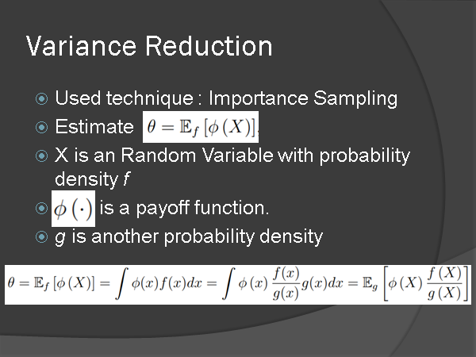

Slide 20
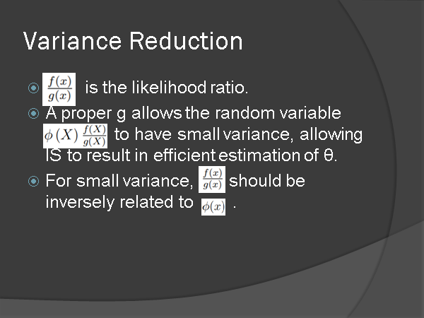

Slide 21
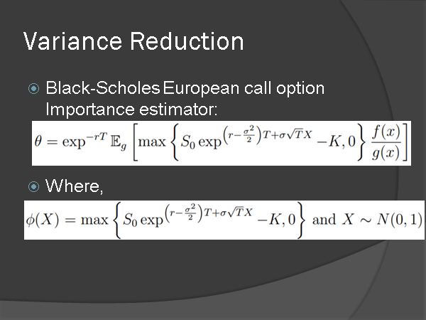

Slide 22
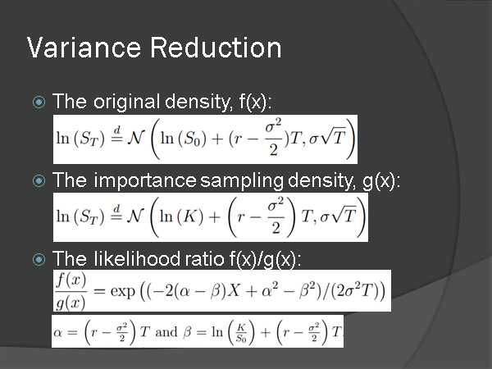

Slide 23
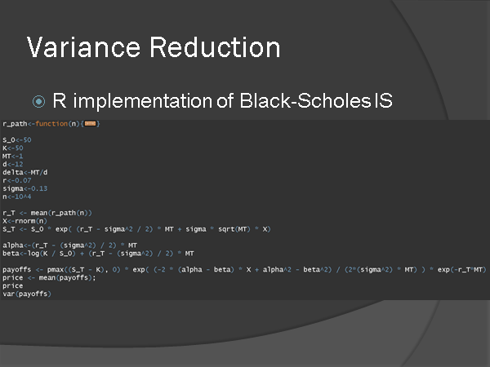

Slide 24
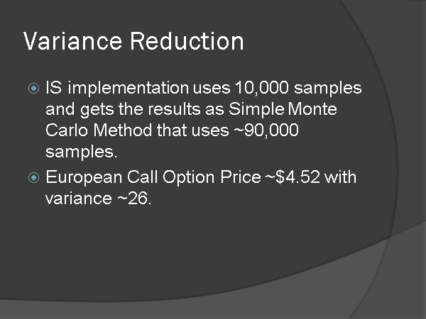

Slide 25
References
Stigler, S. 2012. The Use of Importance Sampling to Speed Up Stochastic Volatility Simulations,
Shan, Xiaoxue, "Mathematical Models for Interest Rate Dynamics" (2012). LSU Master's Theses. 3895

